Slide 1
24
7
30
Algebra
Date
EQ – Describe how we use the distributive law to expand brackets
PBS MATH CLUB Video
Distributive Property – Friendship Bracelets and Oprah
(first 1 min 50s)
https://youtu.be/n99K96Ektqo

Slide 2


24
7
30
Algebra
Date
EQ – Describe how we use the distributive law to expand brackets
Distributive Law - Revision
2 (y + 3) = 2xy + 2x3 = 2y+6 The “2” outside the brackets multiplies onto all letters and numbers that are inside the brackets.

Slide 3
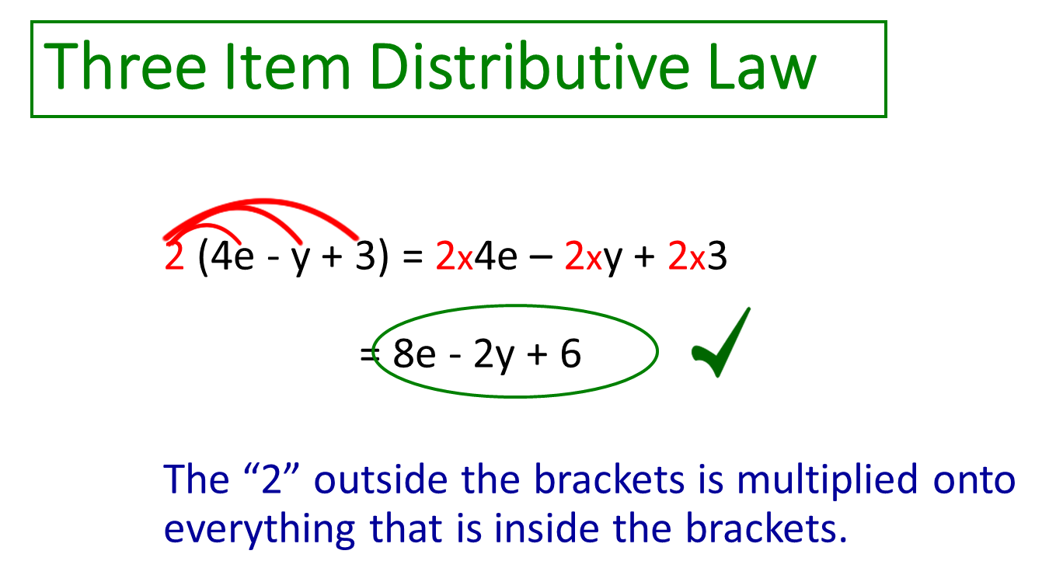
24
7
30
Algebra
Date
EQ – Describe how we use the distributive law to expand brackets
Now an example with 3 terms inside the brackets:
The rules stay the same.

Slide 4
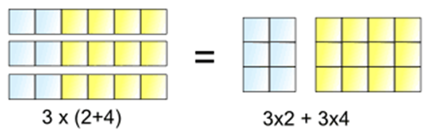
24
7
30
Algebra
Date
EQ – Describe how we use the distributive law to expand brackets
Can the distributive law be displayed graphically?
The "Distributive Law" is written as:
a × (b + c) = a × b + a × c
It means
3 lots of (2+4) is the same as 3 lots of 2 plus 3 lots of 4

Slide 5
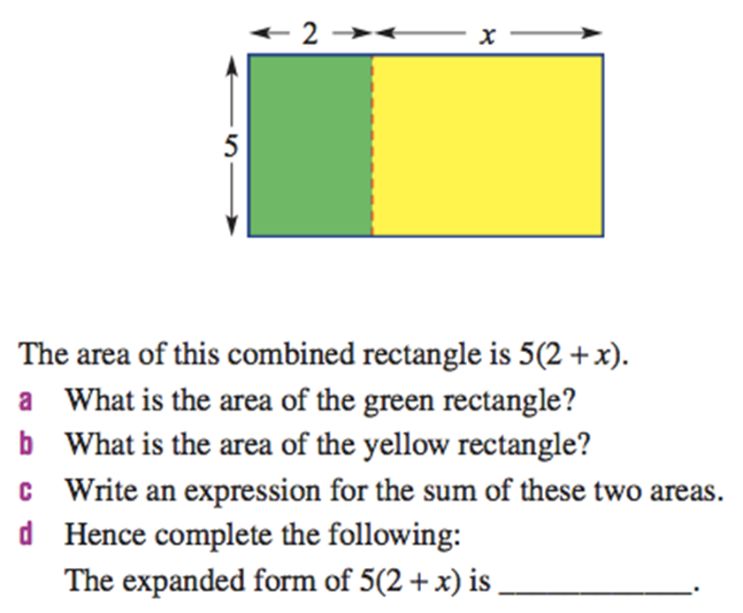
24
7
30
Algebra
Date
EQ – Describe how we use the distributive law to expand brackets

Slide 6
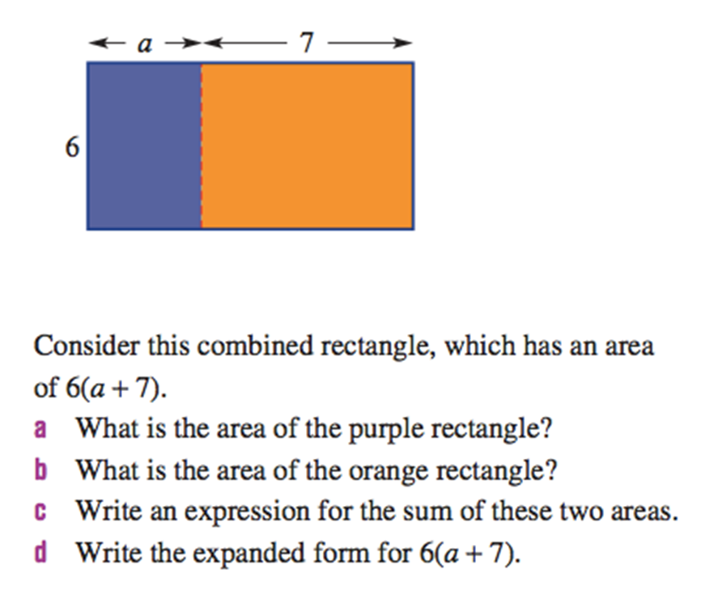
24
7
30
Algebra
Date
EQ – Describe how we use the distributive law to expand brackets

Slide 7
24
7
30
Algebra
Date
EQ – Describe how we use the distributive law to expand brackets
Exercise and homework – Ex 3.10, page 40 Dwyer book.

